Slide 1
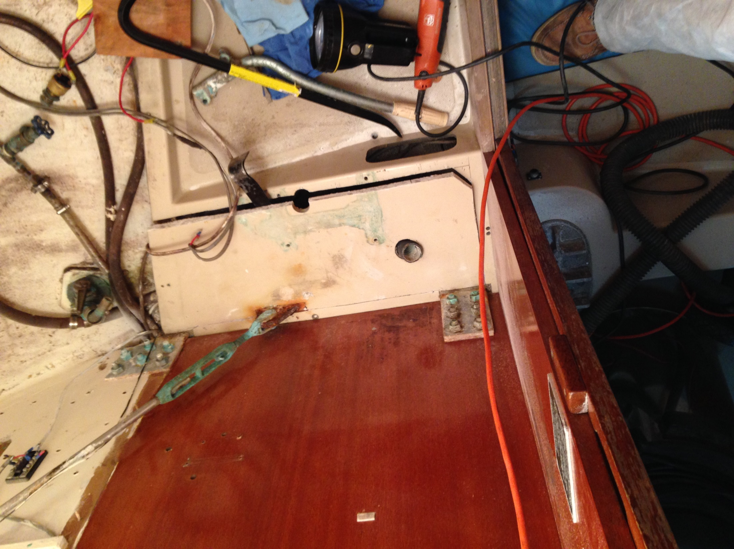
Step 1: Cut and extract toilet platform floor. Note: it is bonded to the top of the I-beam. Lots of sweat, swearing, prying and hammering to bust it loose. Fien reciprocating saw is a godsend here.

Slide 2
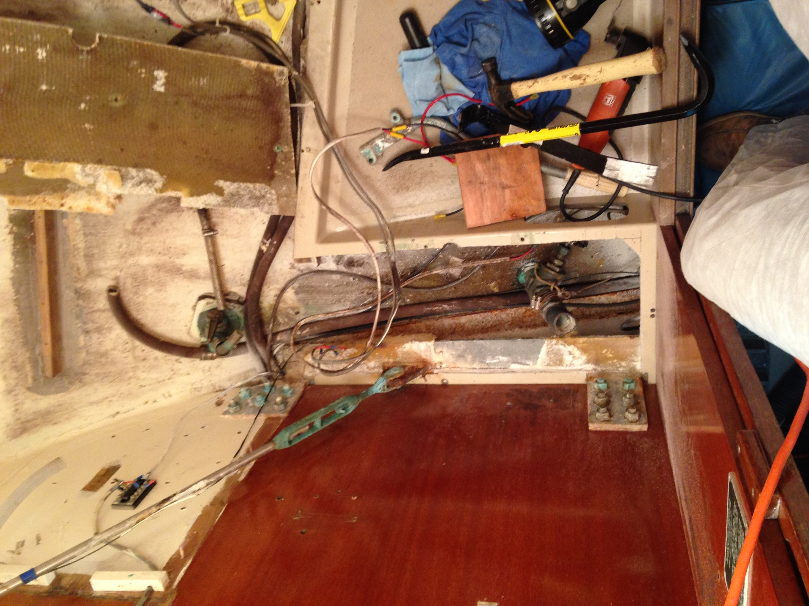
Beam corrosion is mostly confined to port tension bar tang and lower I-beam flange

Slide 3
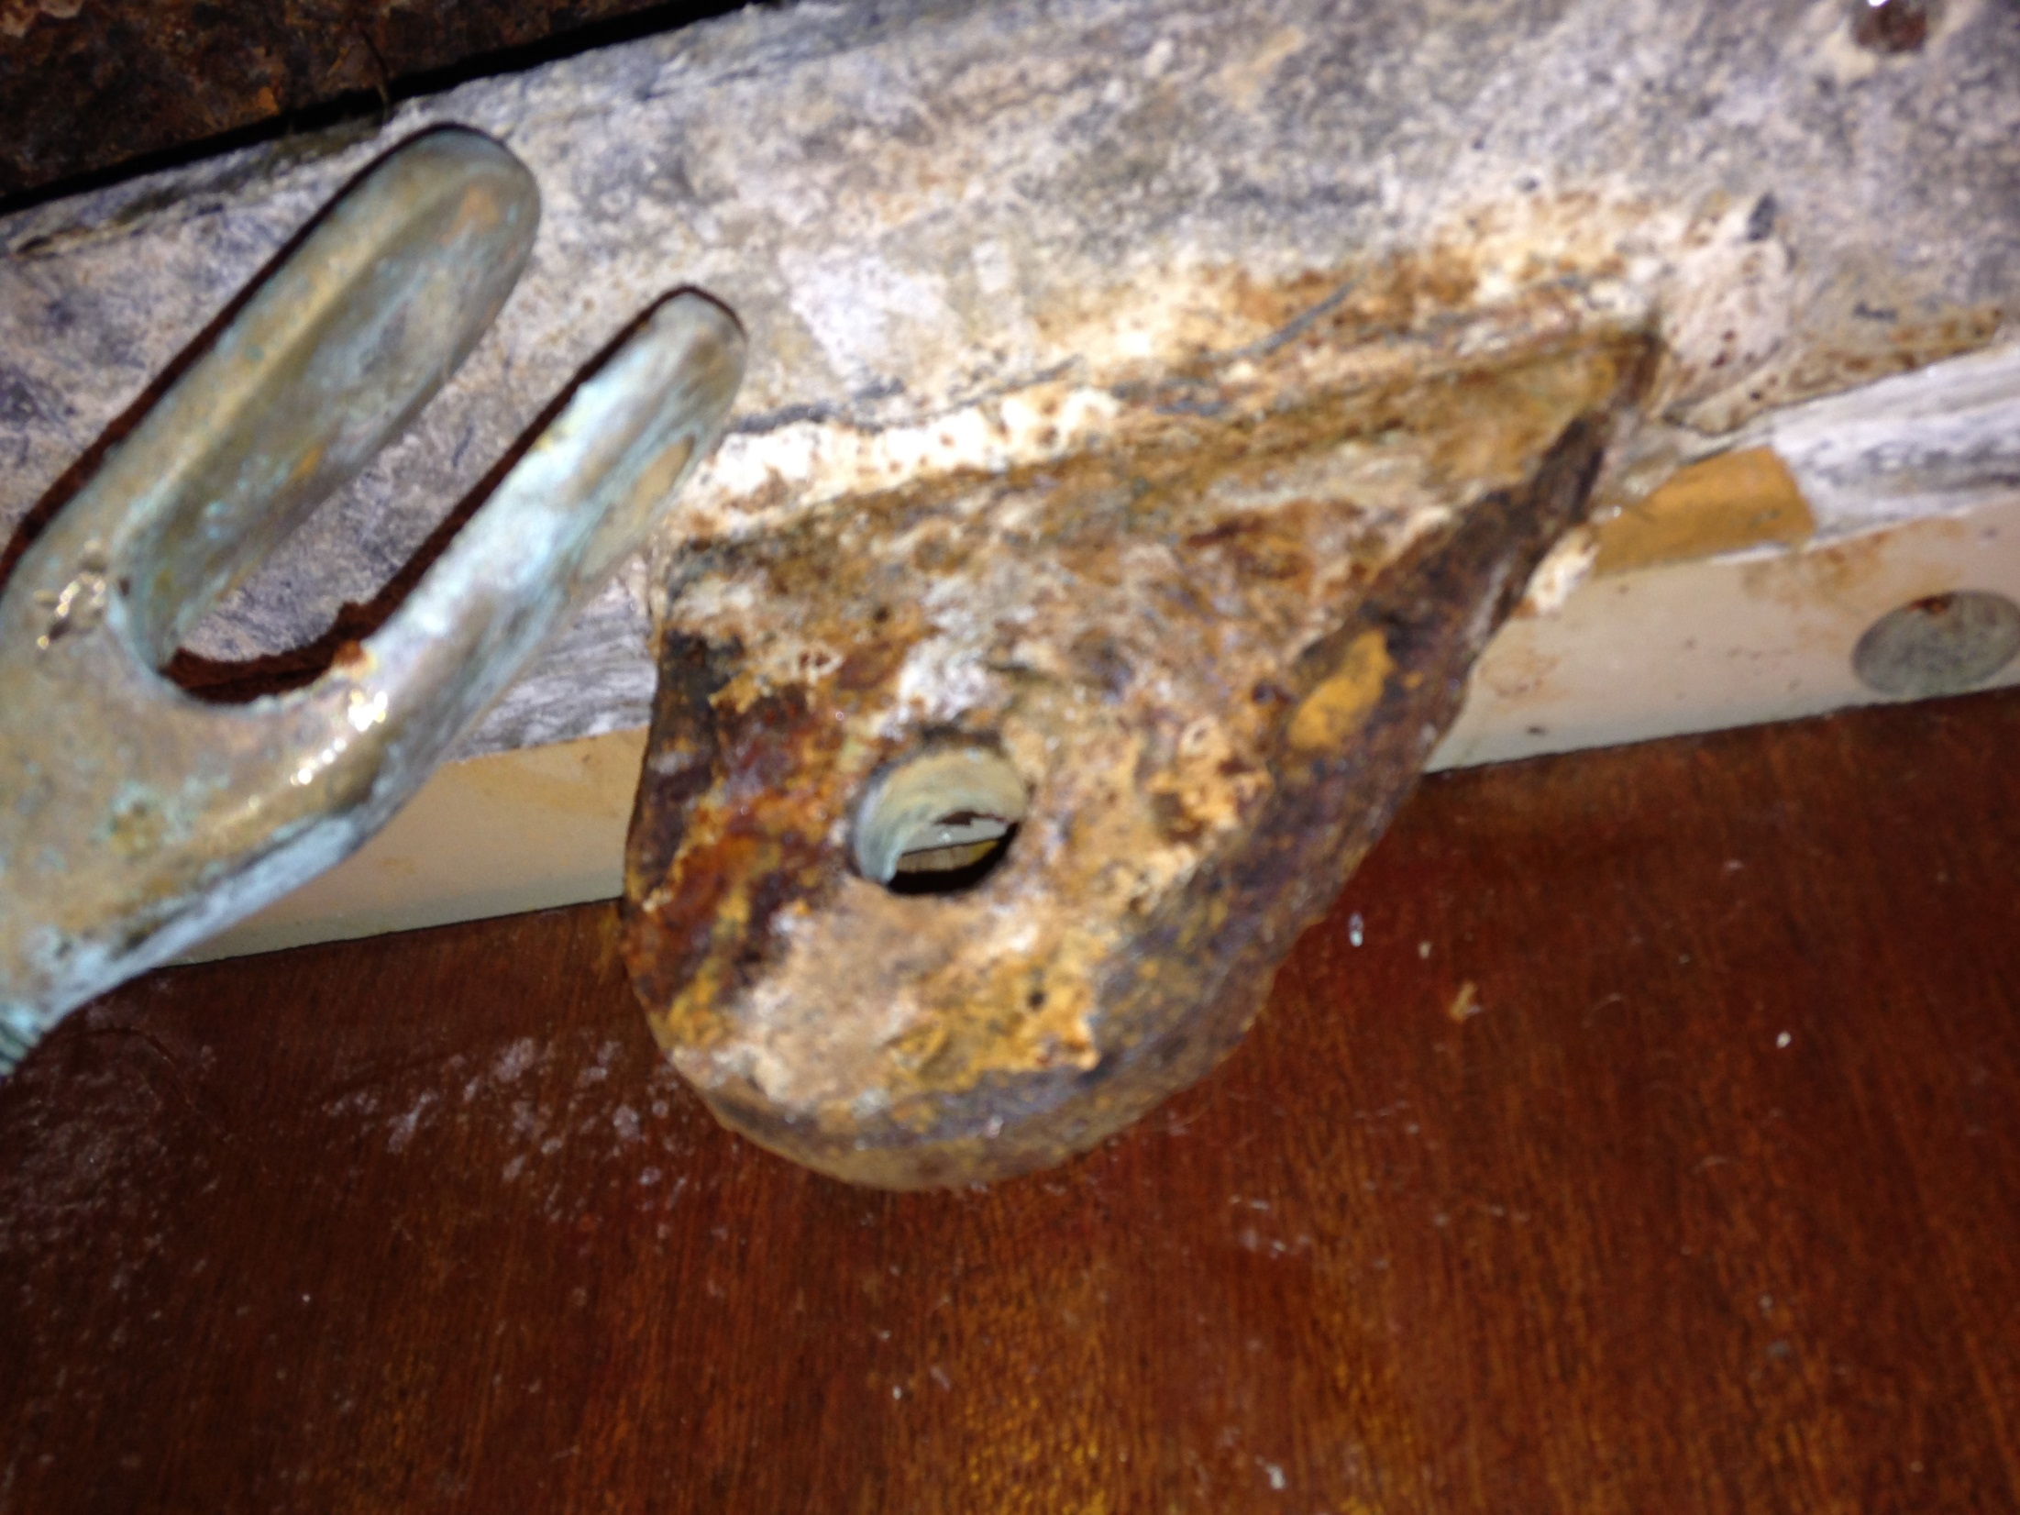
Despite nasty look, rust on tang is surface rust only and chips off with a little effort. De-rusted tang still measures about .350 inches, about 90% of original 3/8” thickness. Weld is still solid and stands up to the sledge hammer test.

Slide 4
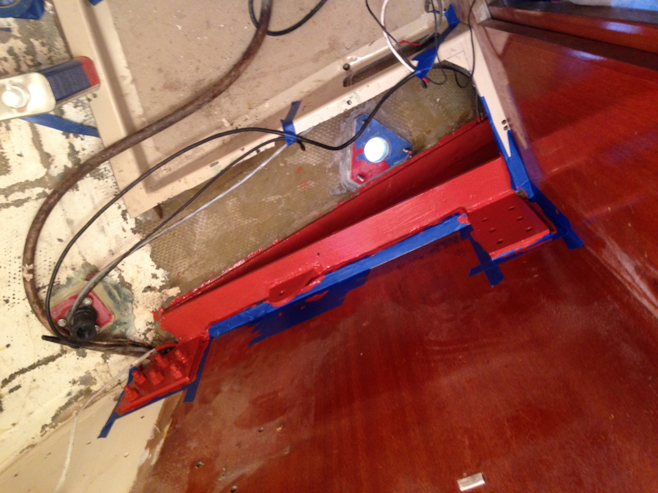
After chipping off all the rust I could reach, I hit the beam with 2 coats of rust converter (trade name: “888 Rust Knock Out”). The only worrisome area is the bottom of the I-beam flange resting against the hull that I was unable to de-scale and treat, but given the limited actual metal lost to rust on the accessible surfaces, I doubt there will be a structural issue.

Slide 5
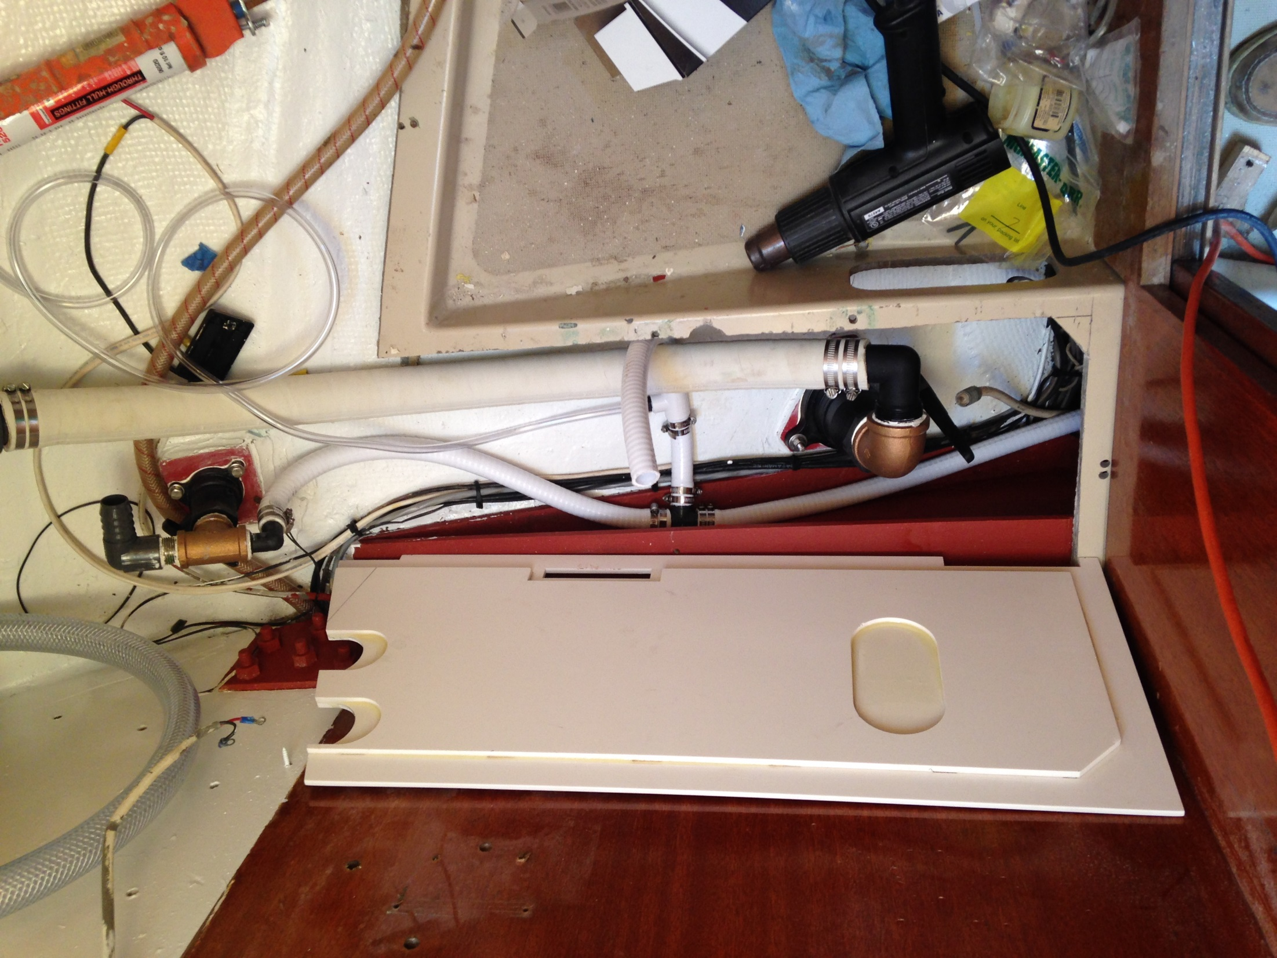
After replacing ancient seacocks and thru-hulls, I re-capped the throne platform with a new surface made of 2 laminated layers of ¼” fiberglass sheet . (Having a sailing buddy with a waterjet cutter was a total bonus!)

Slide 6
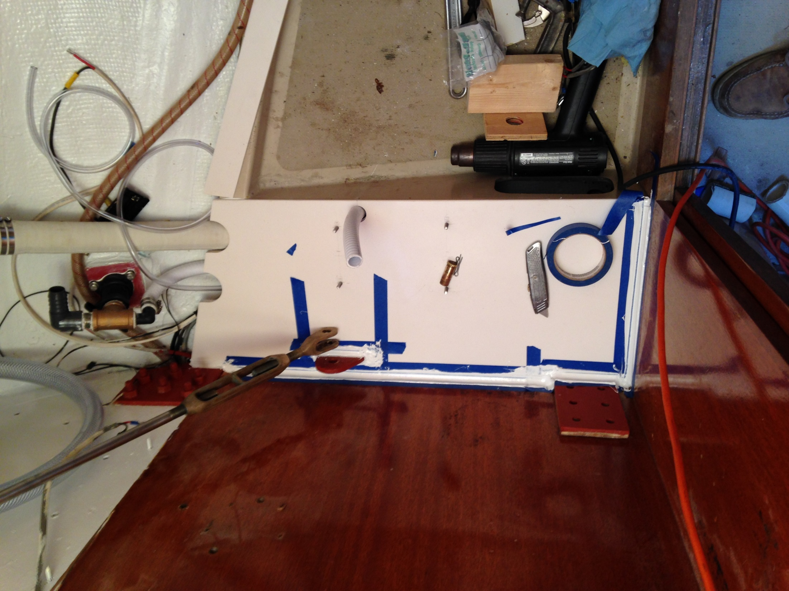
The new platform top is bonded in with 3M 4200 and calked around all edges to prevent any water or, um… careless overspray, from getting to the beam. While not as thorough as a total beam replacement, this approach is far less invasive if your beam is not too far gone.

Slide 7
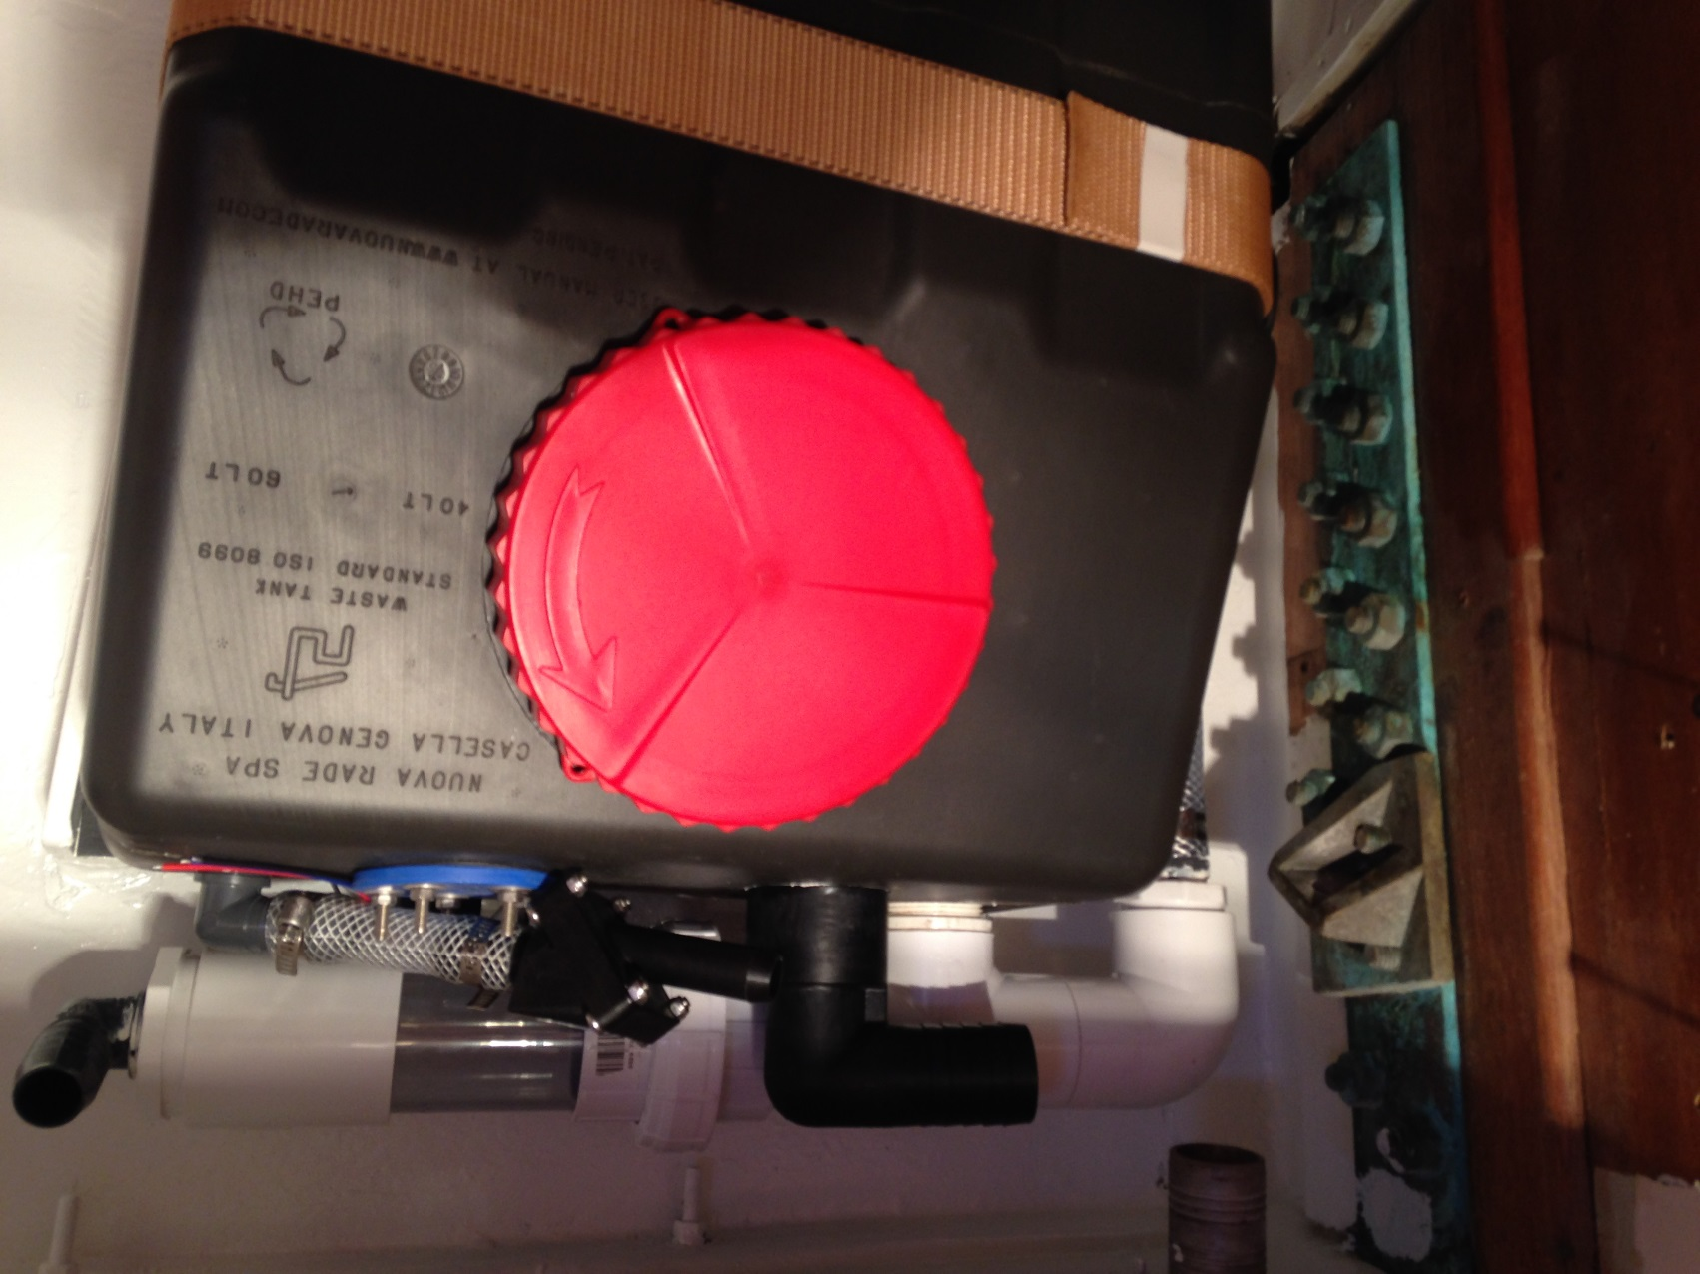
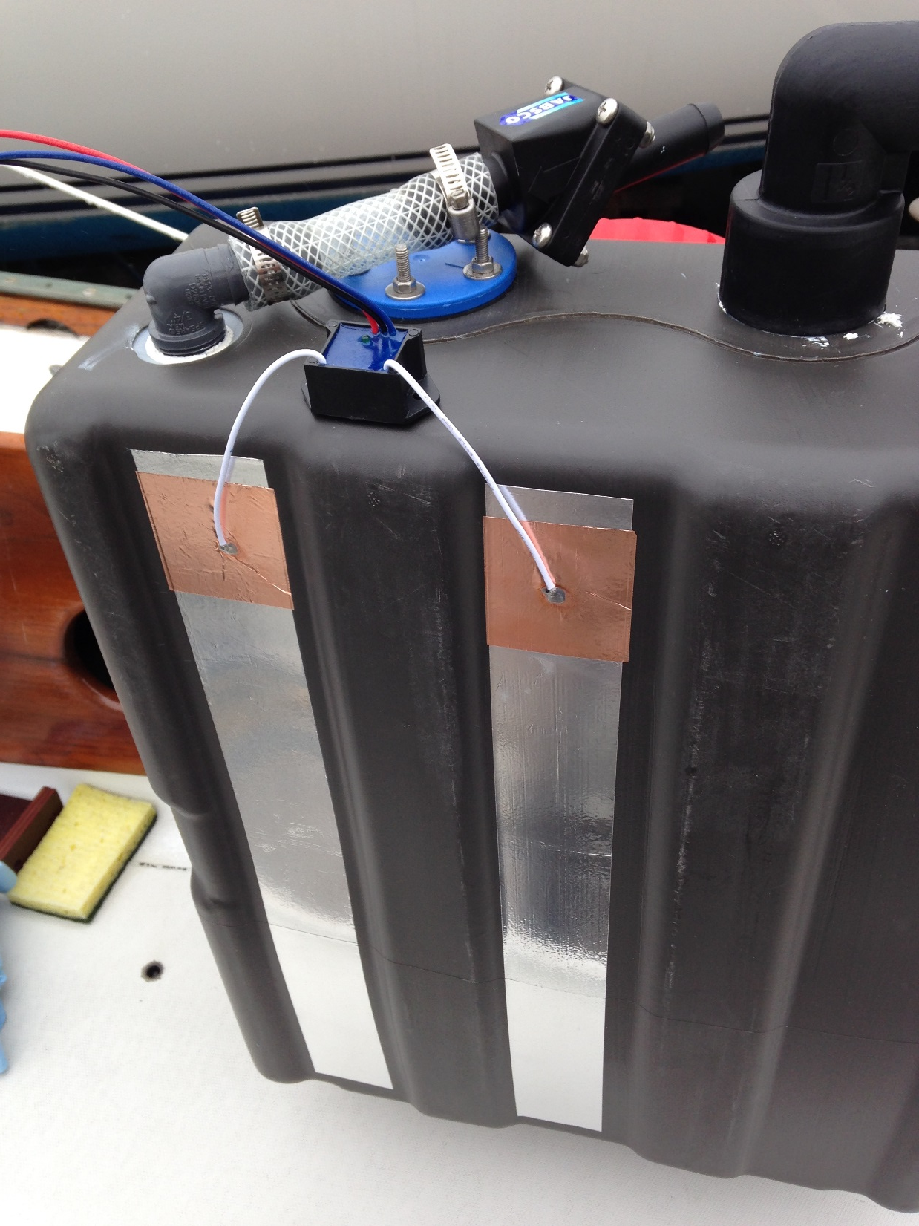
Next: New waste tank is gravity drain type. Almost every French made charter boat in the Caribbean uses this sort of tank because there are no pump-out facilities. Charter briefing says “go out 3 miles and open the valve”.
SCAD Solo™ tank monitor sensor strips

Slide 8
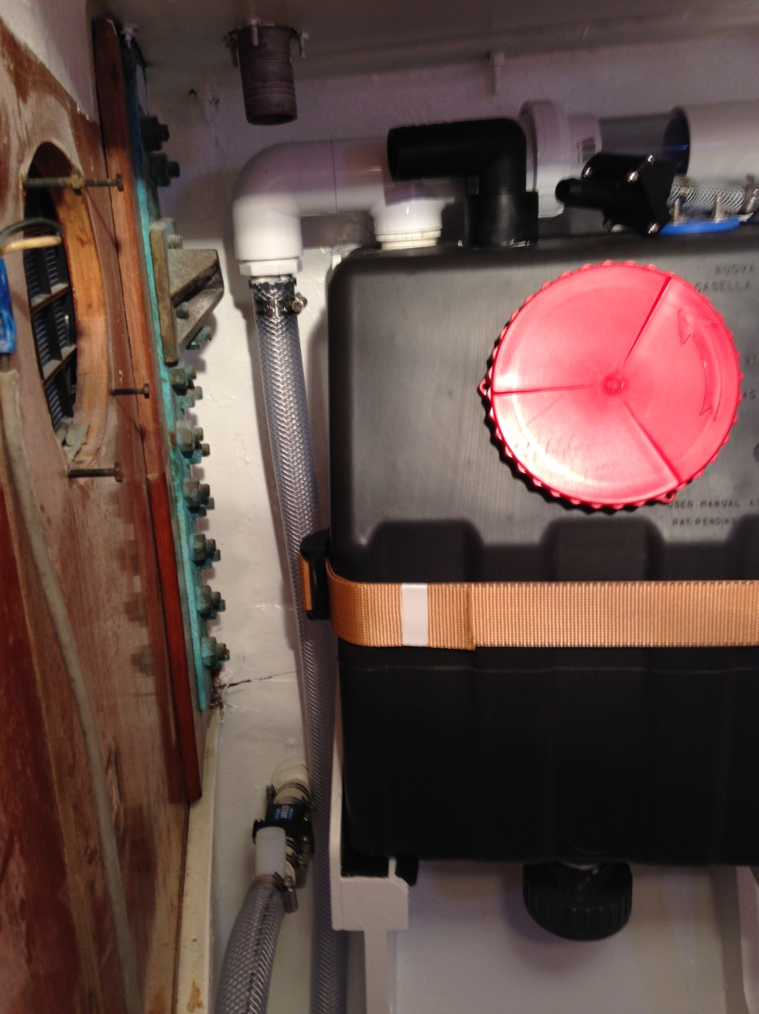
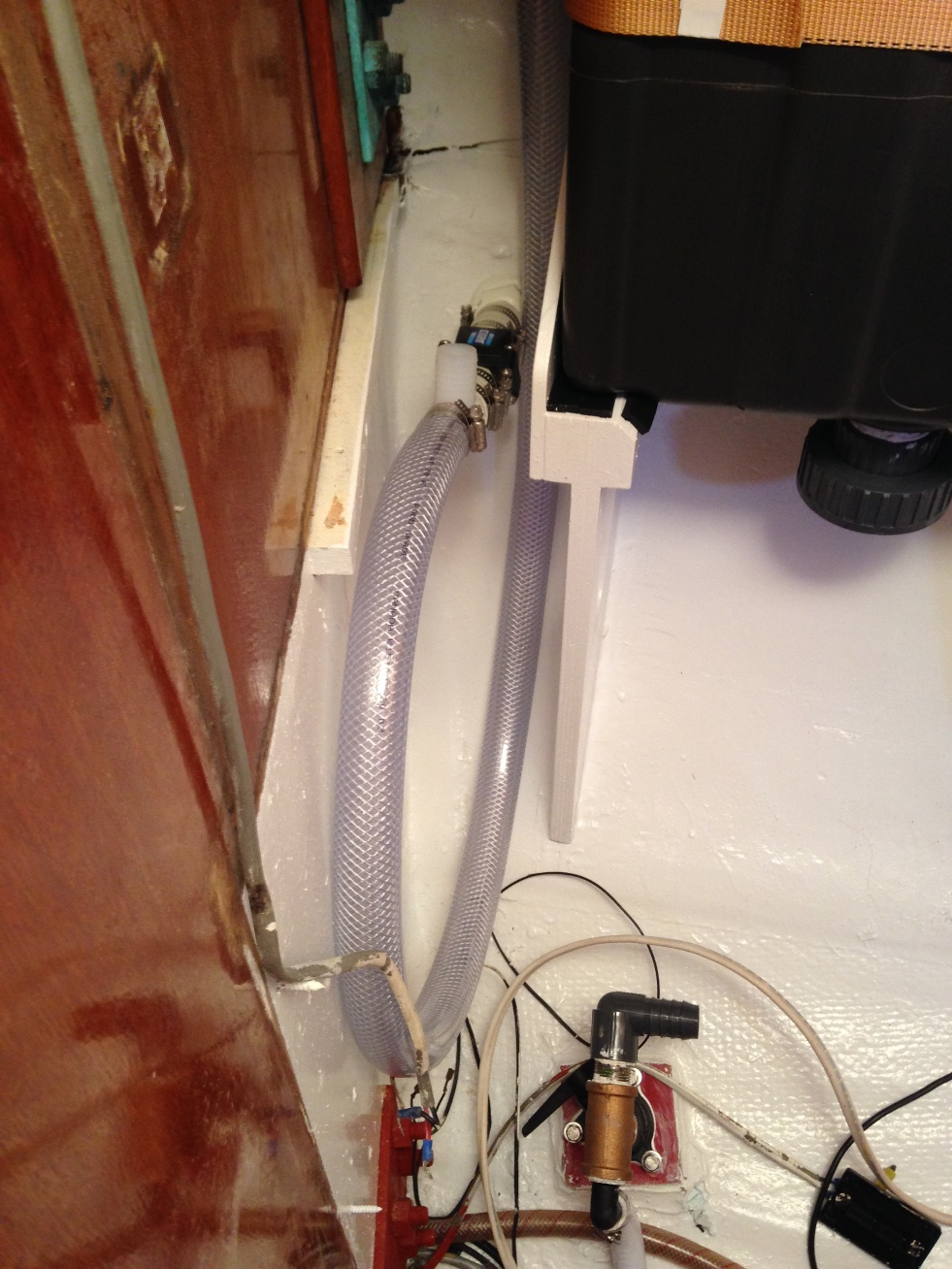
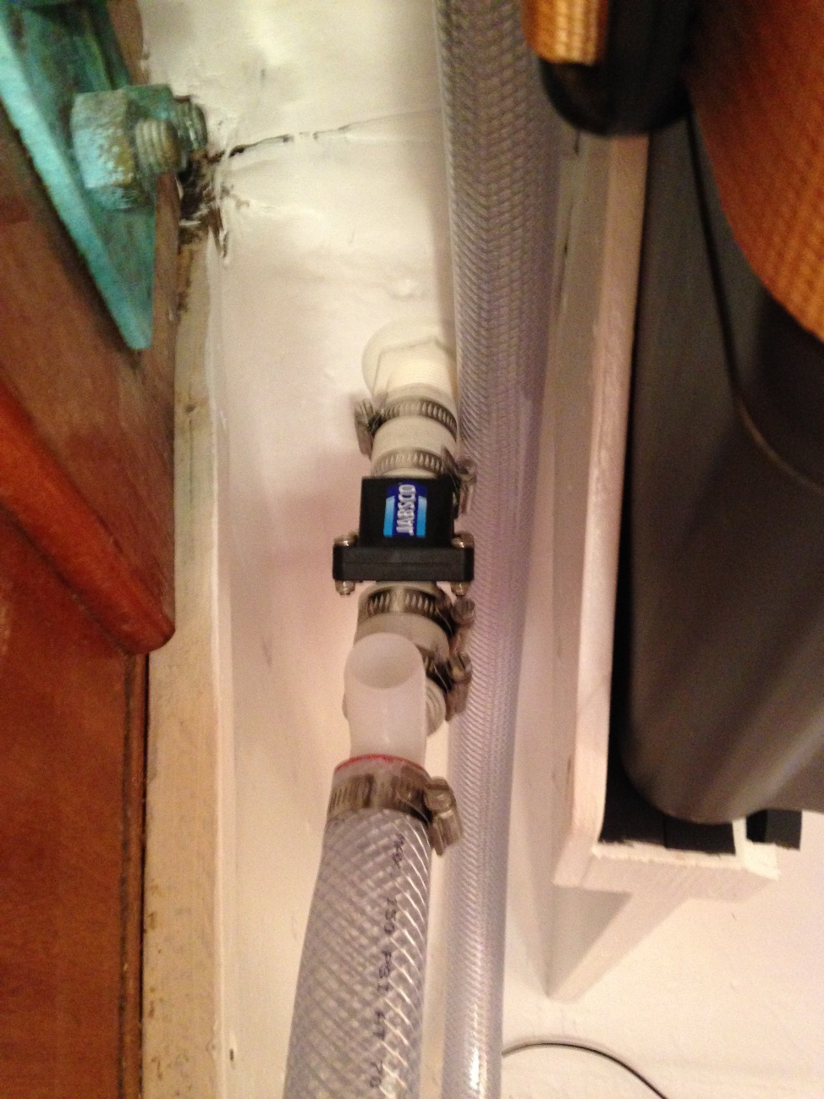
I may have gone a little overboard engineering the tank plumbing. The vent goes through a home made charcoal filter. There is a filter bypass in case of overflow through a water filled loop. A check valves prevents the tank filling with water when healed far to port, and a inlet vent at deck level lets air in with a check valve to keep stink from emanating at deck level.

Slide 9
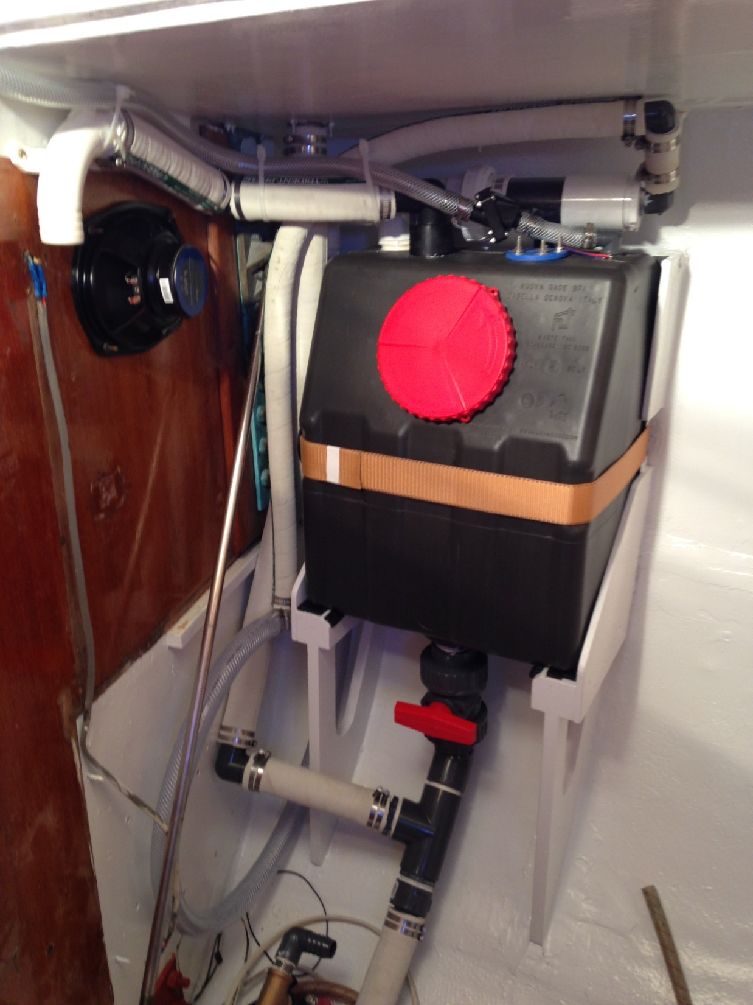
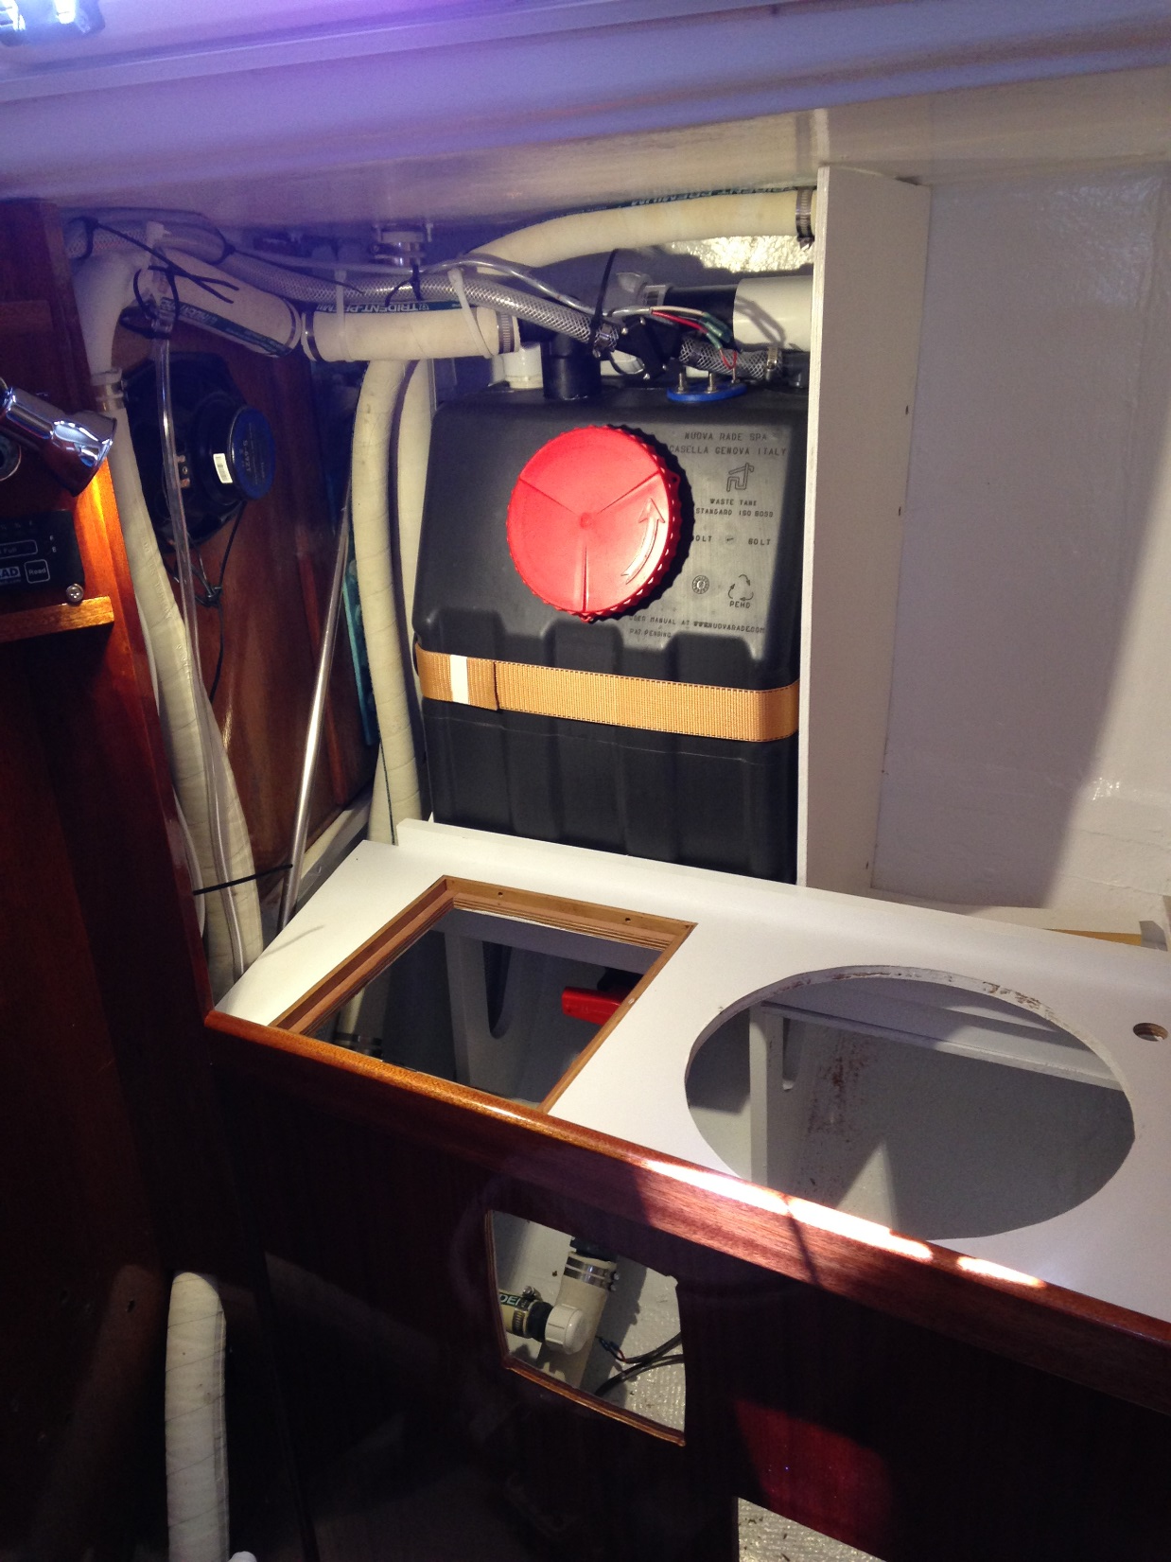
The deck pump-out tee’s into the discharge line between the drain valve and the seacock. When sediments inevitably clog the gravity drain (a traumatic charter boat experience I will never repeat involving a snorkel and a whole lot of antibiotics) a plunger at the deck fitting will clear the clog.

Slide 10
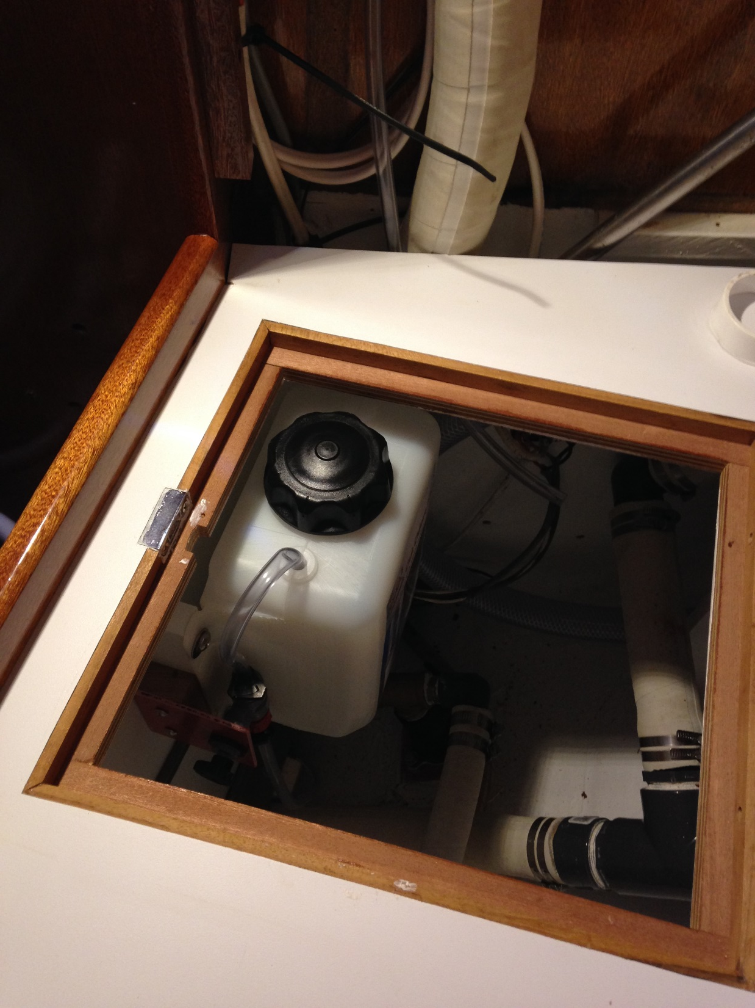
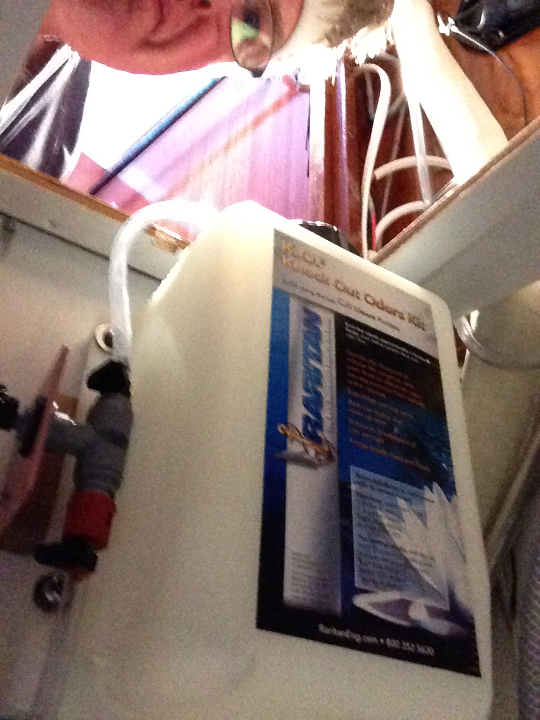
Another stink mitigation measure is installation of a Raritan odor knock-out kit that injects a wee bit of biological based odor control stuff into your toilet seawater intake. (I know a lot of boats are converting to fresh water toilet intake, but Misirlou lives on a mooring, not a marina, and we like to travel light on tank water.)

Slide 11
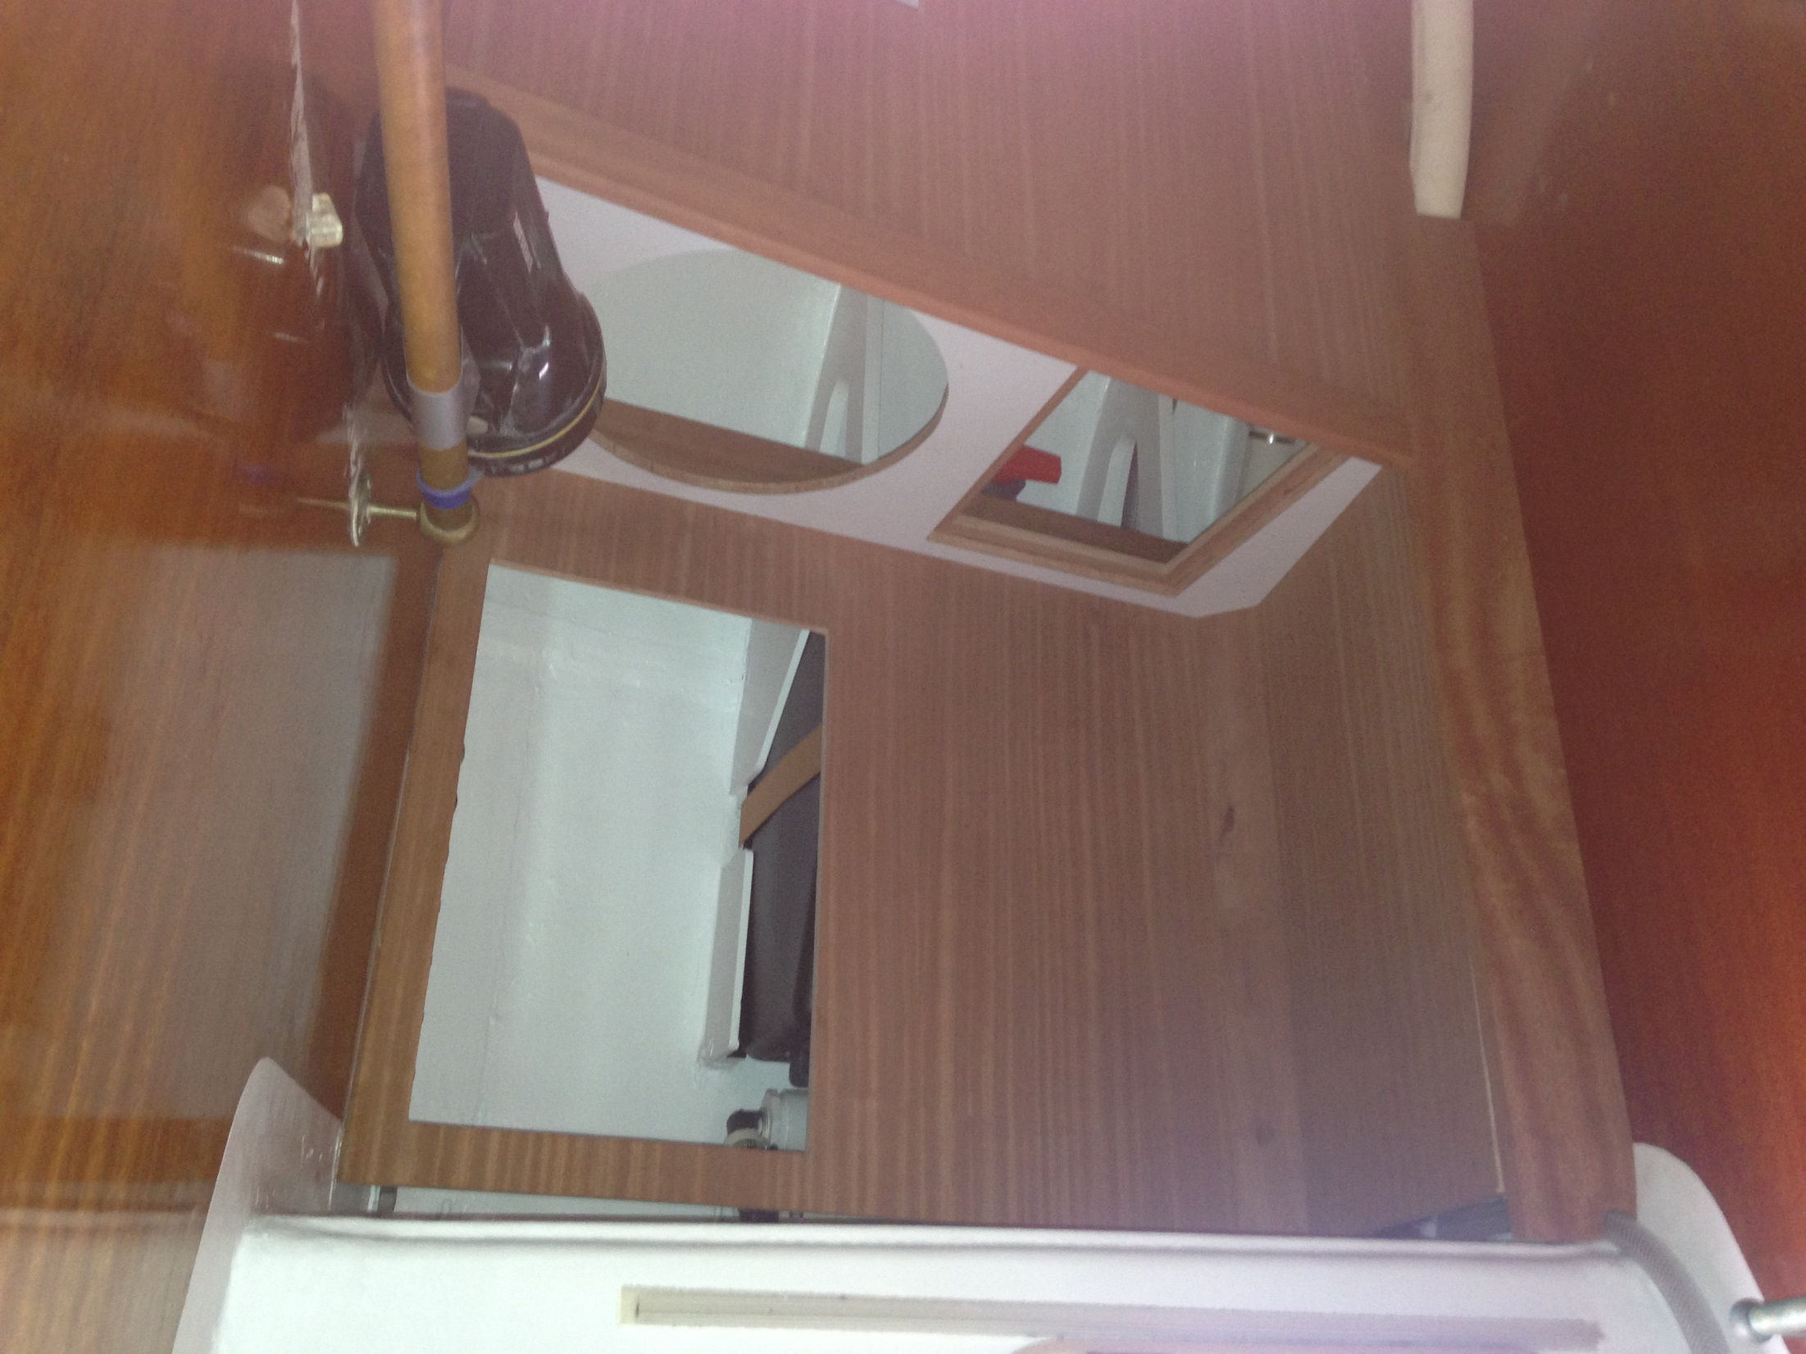
Here we are test fitting the cabinetwork before varnishing. The original Cal 40 bulkheads are (I think) Philippine mahogany, which was cheap and abundant in the 1960s, but impossible to find nowadays. The closest I could get to matching the original woodwork was Sapele (African mahogany-like wood) lumber and marine plywood. It ended up being a pretty good match for the original.

Slide 12
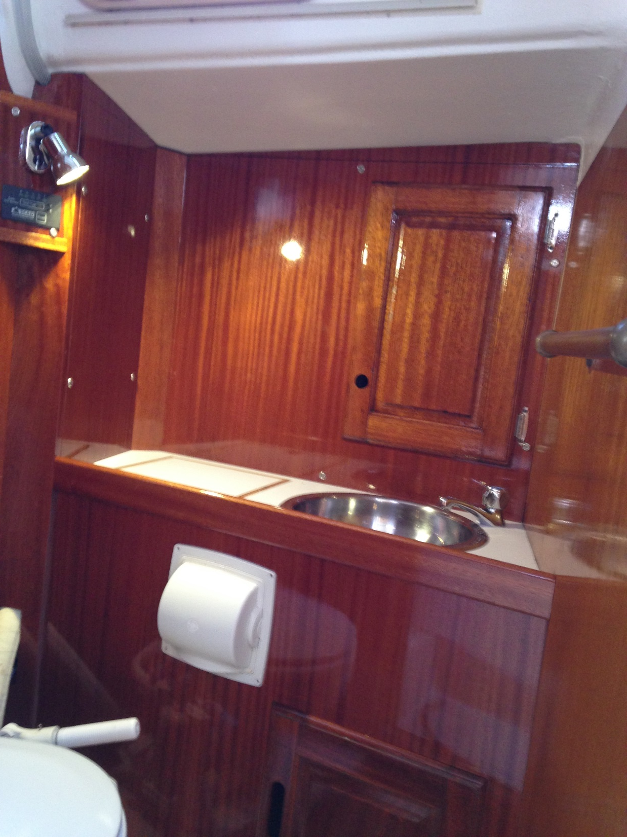
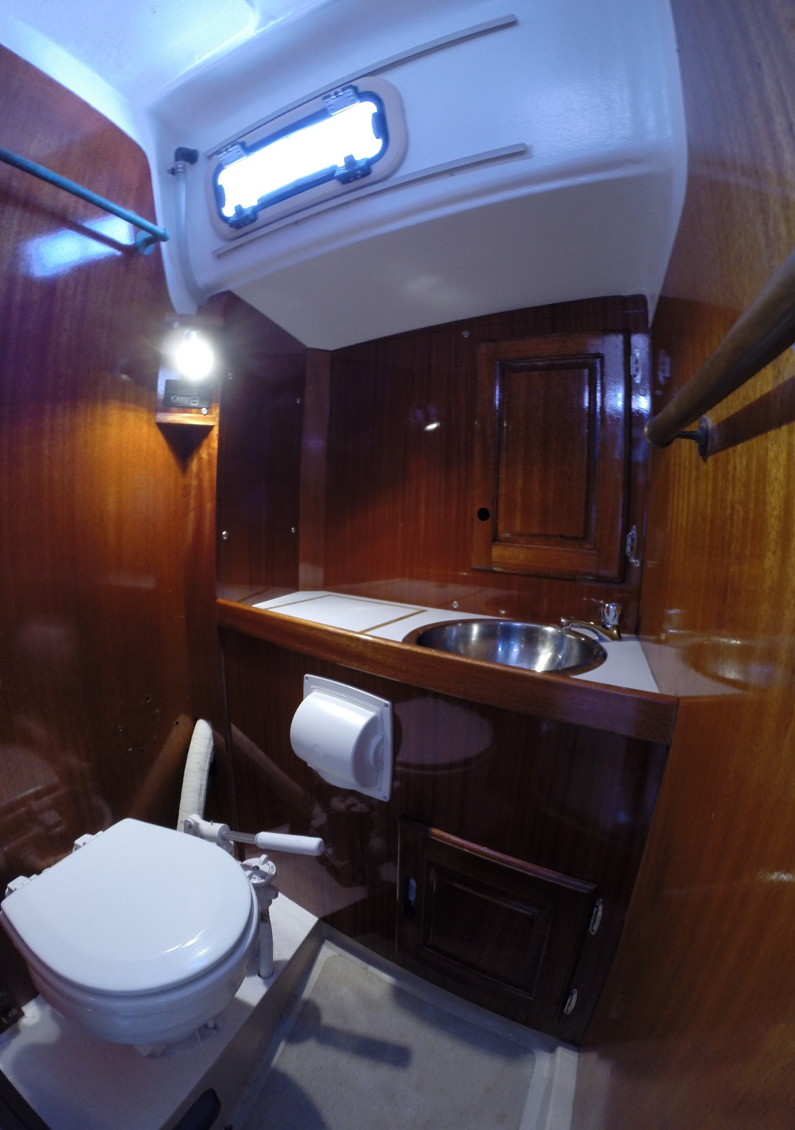
Here is the finished installation with 5 coats of spar varnish. The hatch in the countertop accesses the drain valve when we are offshore. The SCAD Solo™ tank monitor panel is under the LED lamp. I tried to be faithful to the original Cal 40 look, which meant finding a medicine cabinet door that matched. Fin put me in touch with Kelly Marine who had a perfect sized cabinet door. (Possibly left over form the Radiant re-fit?)

